Slide 1
How does a computer work? Introduction to computer hardware
When programming a computer, it helps to have a basic understanding of the underlying hardware. Where do variables get stored? Where are functions or loops executed?
Notes:
Bring in machine?

Slide 2
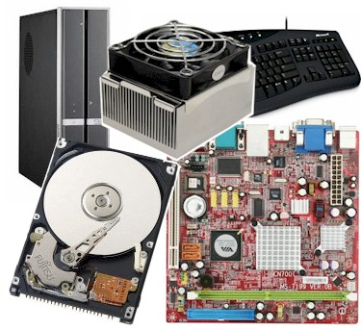

Slide 3
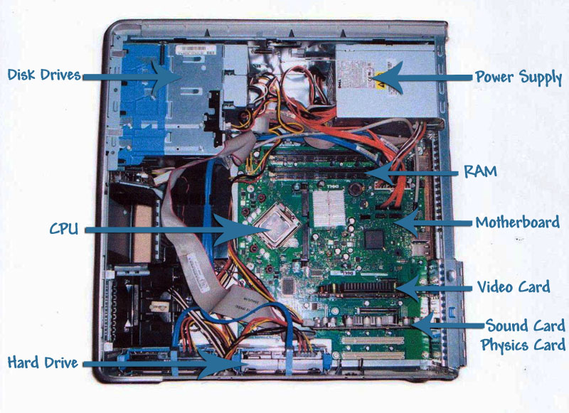

Slide 4
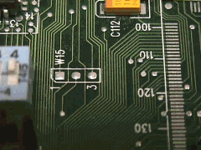
Motherboard
Houses the computer components
Connects them via a bus:
Notes:
What do all the components do?

Slide 5
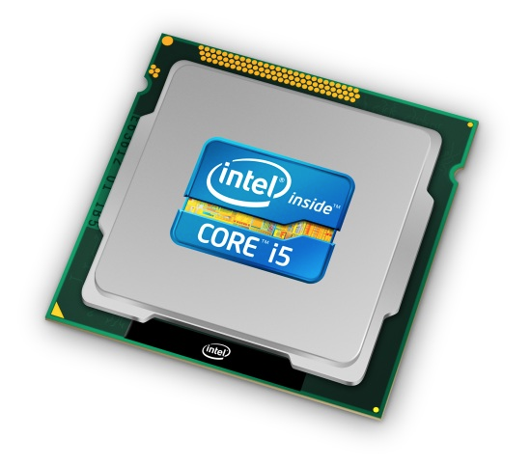
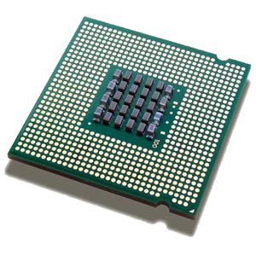
Processor (aka CPU)
Executes program instructions
e.g., performs arithmetic, runs loops

Slide 6
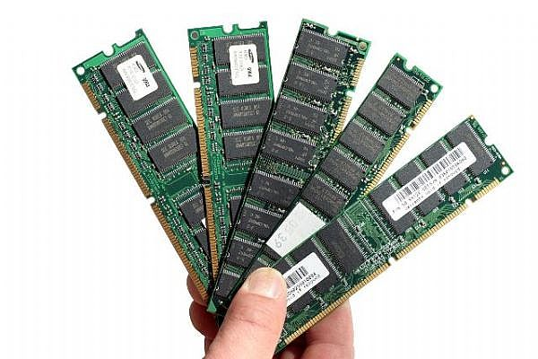
Memory
Stores data & program instructions while programs execute
E.g., stores variables and lists
Volatile: contents lost when computer turned off

Slide 7
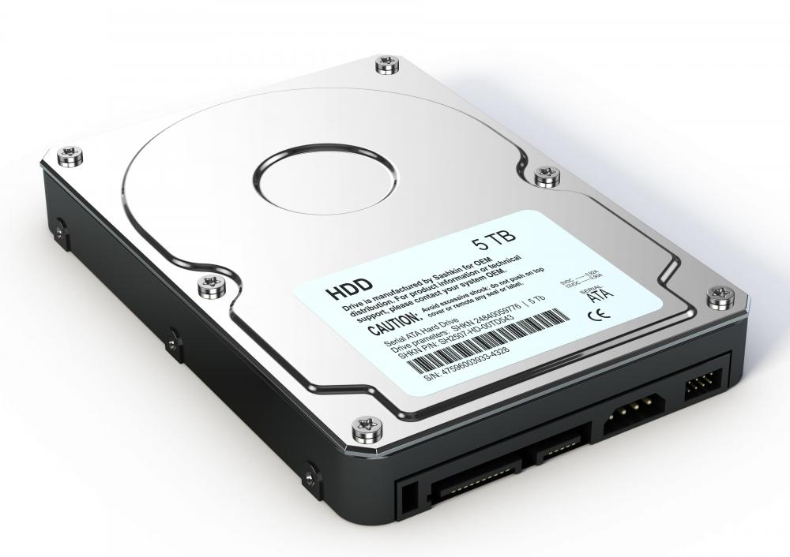
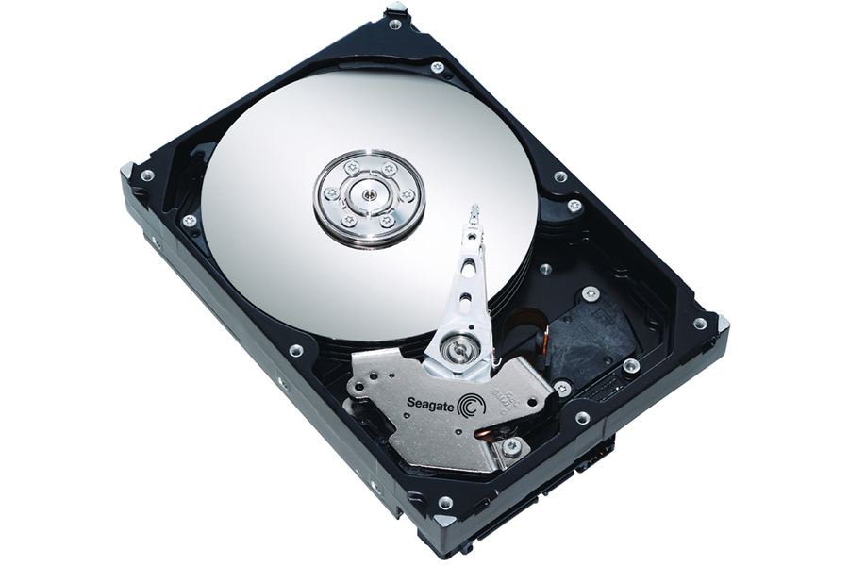
Hard drive
Non-volatile: contents persist (saved) even when computer turned off
Stores data and programs when not running

Slide 8
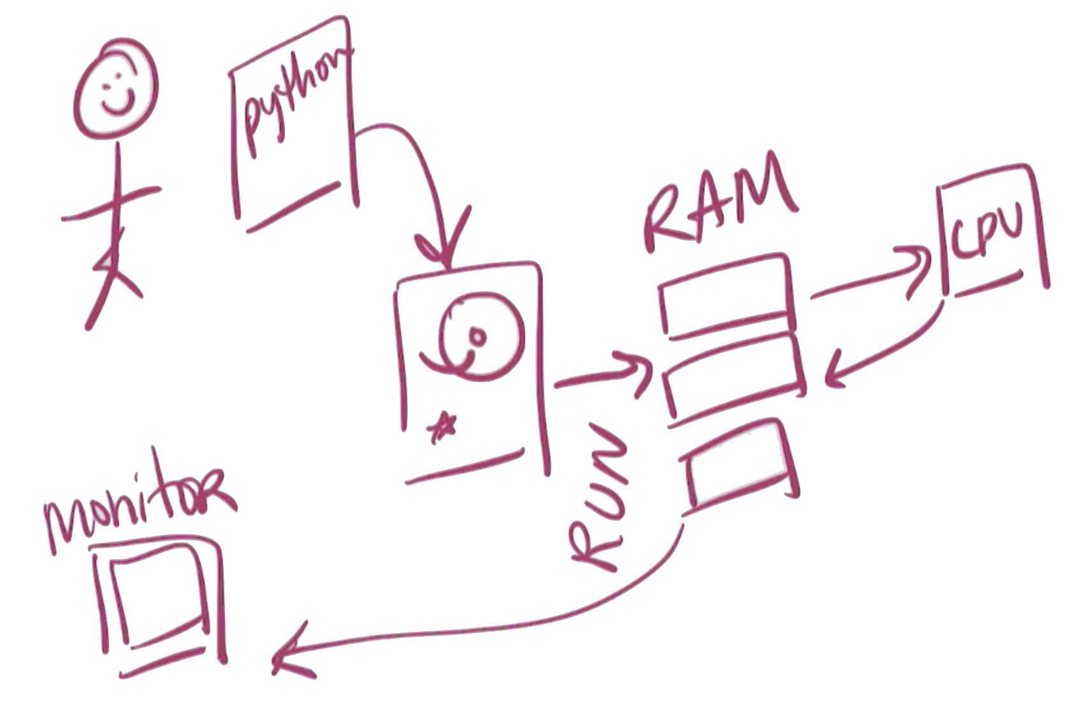
Programming & Hardware

